Slide 1
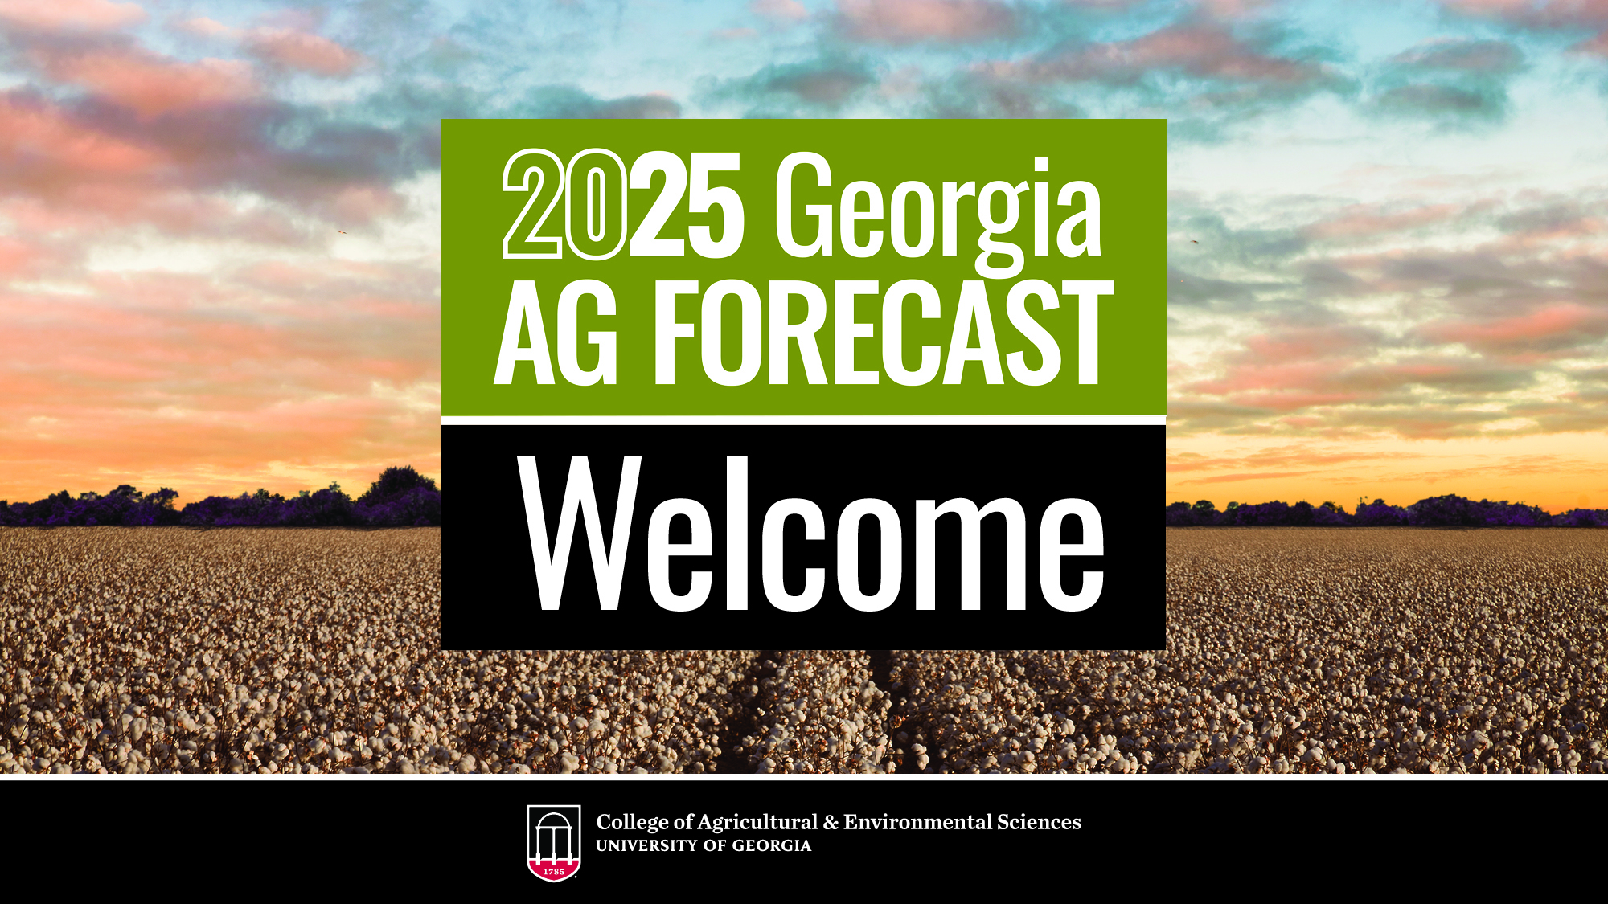

Slide 2
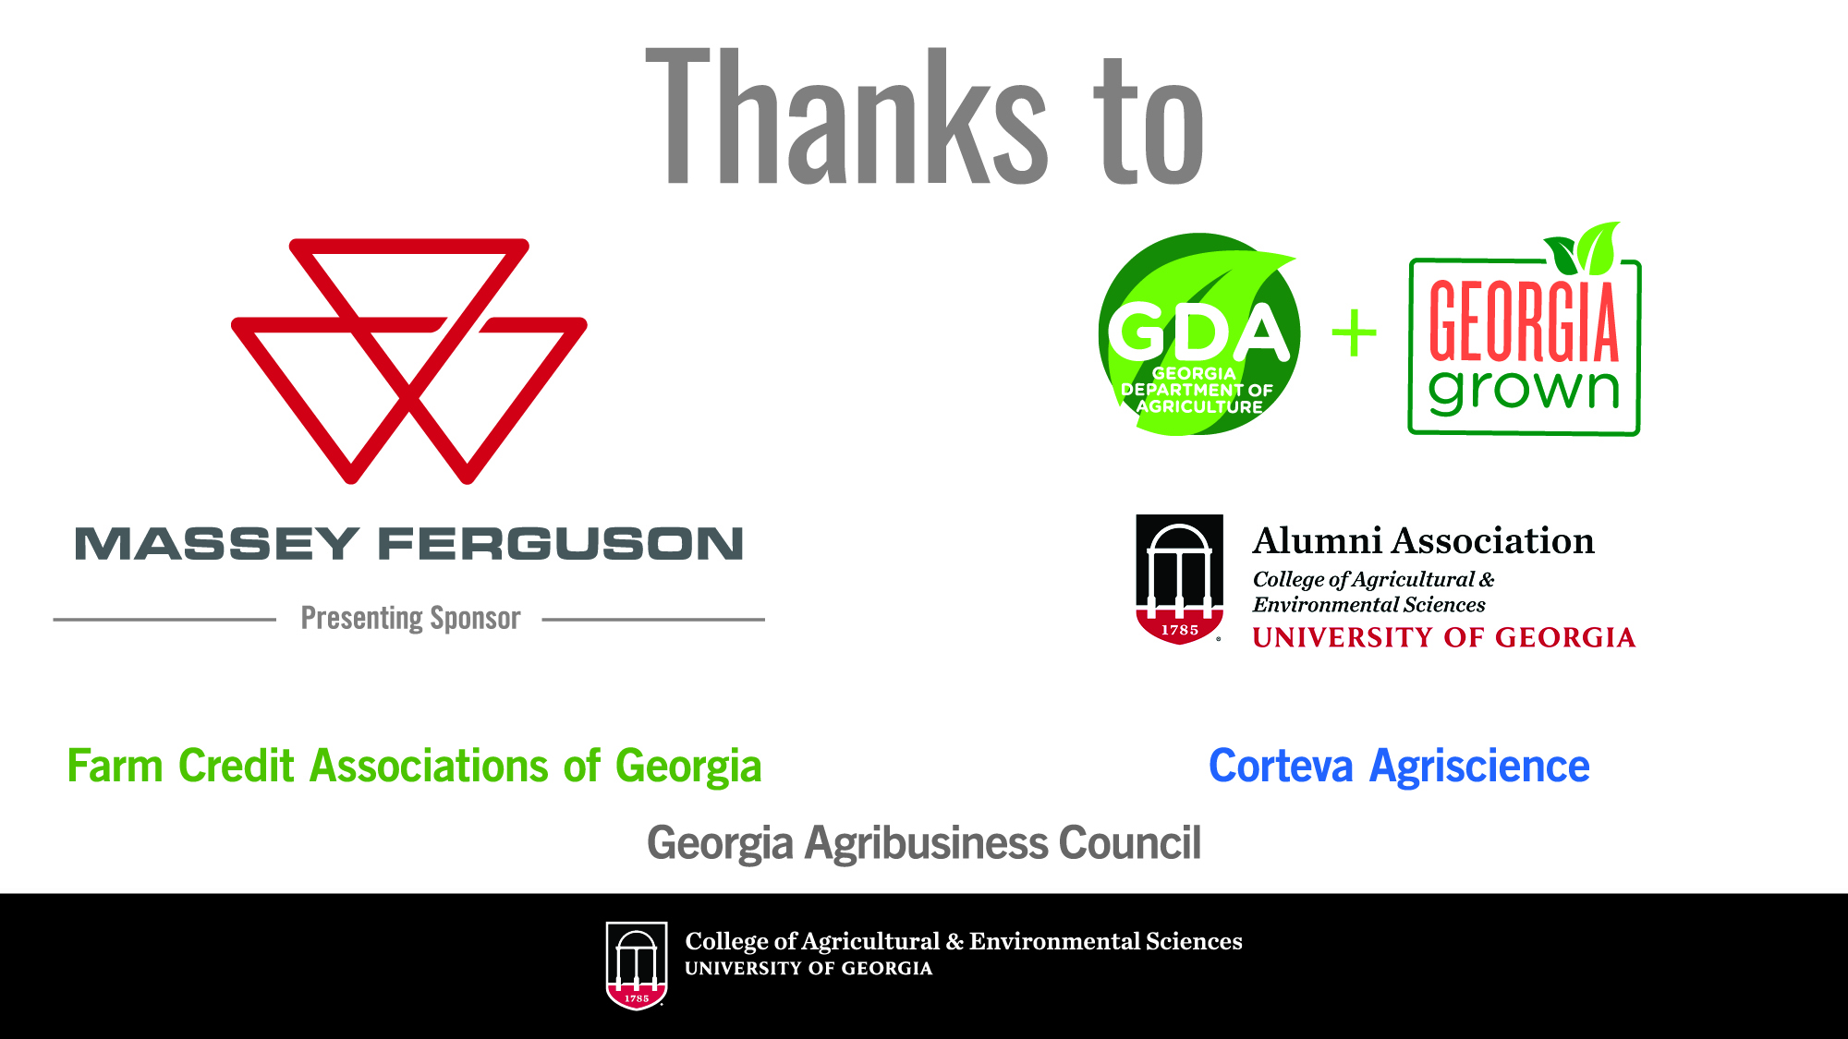

Slide 3


















Faculty Working within Extension
Commodities
Production/
Consumer
Hospitality
General Ag
Dept. Head

Slide 4
Commodity Forecasts
Ag Inputs
Poultry
Beef Cattle
Dairy
Peanuts
Cotton
Other row crops
Fruit/Vegetables
Green Industry
Timber
Direct to Consumer Sales
Hospitality

Slide 5
Production Input and Expenditures Outlook
Farm operating loans will likely be around 8% (7-9%)
Nitrogen and potash supplies remain stable, though challenges with phosphorus persist
Possible tariffs on imported goods could significantly impact potash prices
Georgia H-2A Adverse Effect Wage Rates reach $16.08 per hour in 2025 up from $14.68 in 2024
Total farm production costs are forecast to move slightly lower in 2025 (USDA 2024)
Guy Hancock

Slide 6
H-2A Adverse Effect Wage Rates (AEWR)
Georgia AEWR increased to $16.08 per hour for 2025
AEWR up 34% since 2022
Guy Hancock

Slide 7
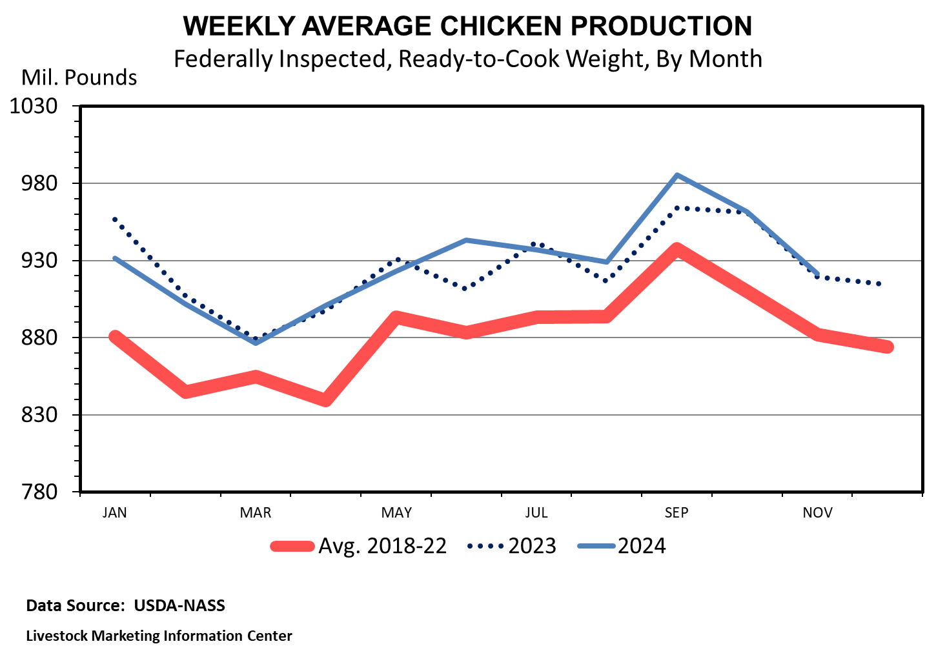
Poultry
Will Secor
Notes:
2024 saw improved pricing for the chicken industry. In 2025, the outlook is generally positive with some risks. With other options at the meat counter more expensive than chicken, domestic demand risks appear low. International demand may be more concerning as exports slid lower last year and are forecast to only see slight improvements in the year ahead. The risk is that chicken production ramps up and exceeds demand and current price levels. If so, prices could fall.

Slide 8
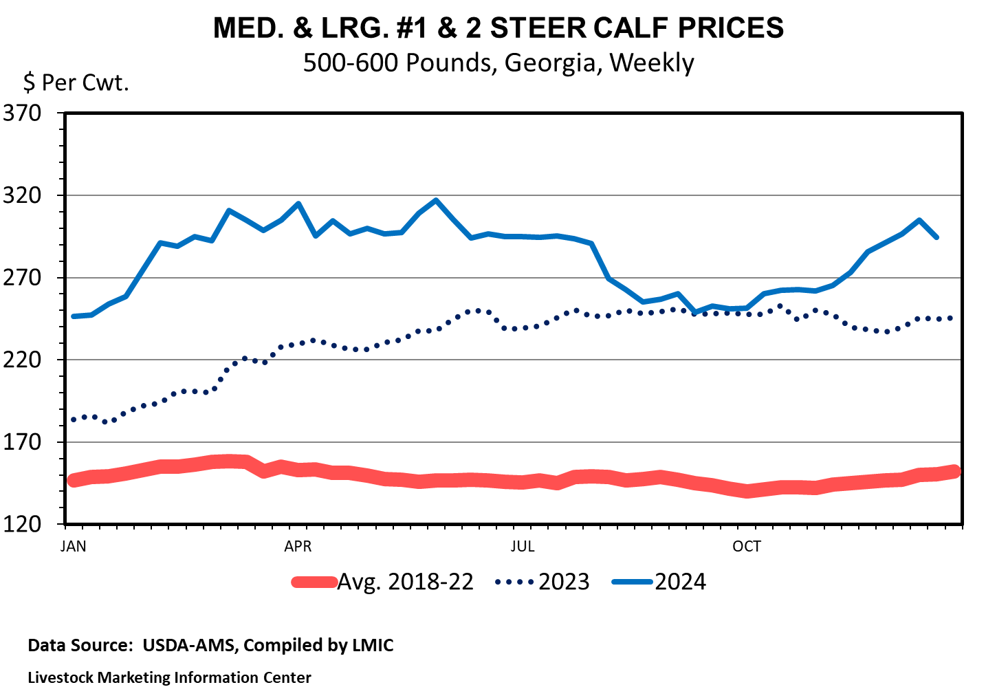
Beef Cattle
Will Secor
Notes:
Beef cattle industry saw strong prices on tight supplies and strong demand. Prices for feeder cattle moved higher through the spring on these factors and saw prices move lower through the fall on normal seasonal patterns (more lighter weight calves coming to market). The expectation in the year-ahead is for this to continue with risks appearing to arise from any demand constraints domestically or internationally.

Slide 9
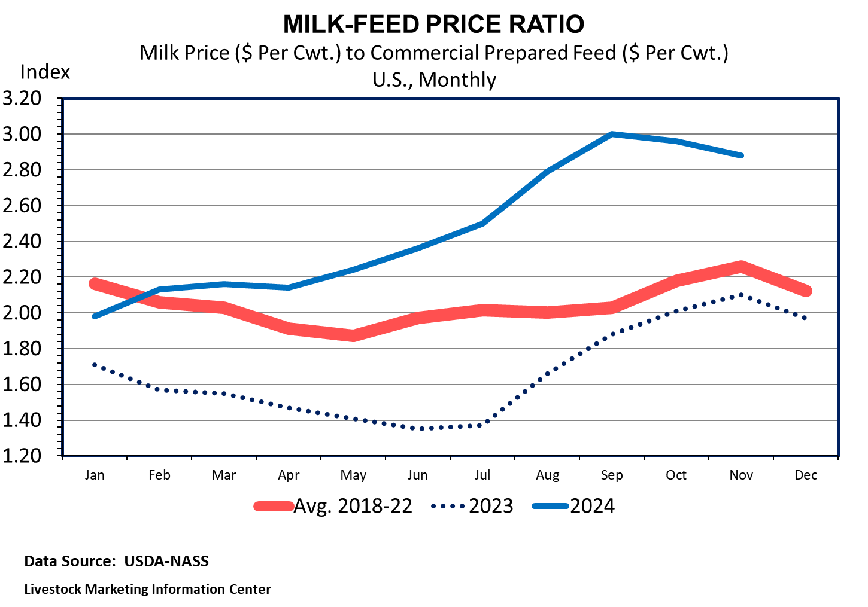
Dairy
Will Secor
Notes:
Dairy producers saw improved margins in 2024 after a very difficult first half of 2023. This has largely come from supply reductions. The outlook for 2025 is stable. The question is whether, or by how much, production expands in 2025. Does it outpace demand? Another significant risk could be widespread HPAI impacts in dairy. So far, this has not occurred, but it is certainly a risk to the industry.

Slide 10
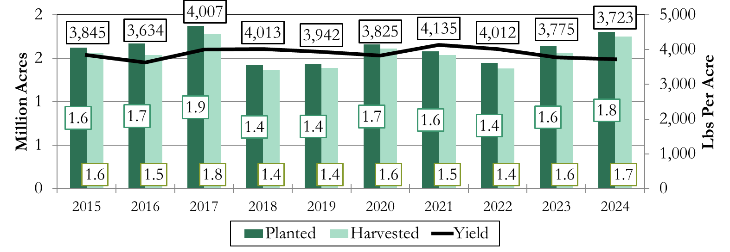
US Peanut Acres and Yield
Yangxuan Liu
Notes:
US planted 1.8 million acres, 9.7% from last year, and is projected to harvest 1.7 million acres.
US yield projected at 3,723 lbs/ac

Slide 11
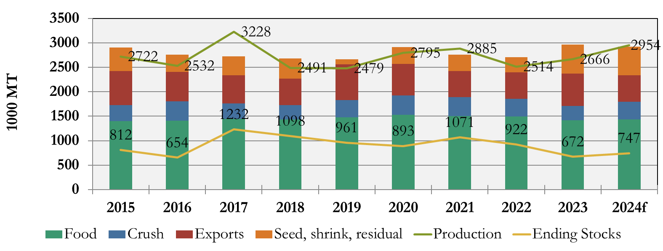
U.S. Peanut Supply and Demand
Source: Data from USDA FAS
Yangxuan Liu
Notes:
Peanut production up in 2024 to 3.0 million metric ton, 10.8% increase from last year.
Due to increased acres
Despite lower yield nationwide and in Georgia
Slightly reduced peanut demand, but still strong demand expected to keep stocks stable. Food use is the largest category in demand.
Consumer food purchases strong, but growth has leveled off. Amond the food use, peanut butter is largest consumed category, followed y peanut snacks, and peanut candy, and in shell peanuts.

Slide 12
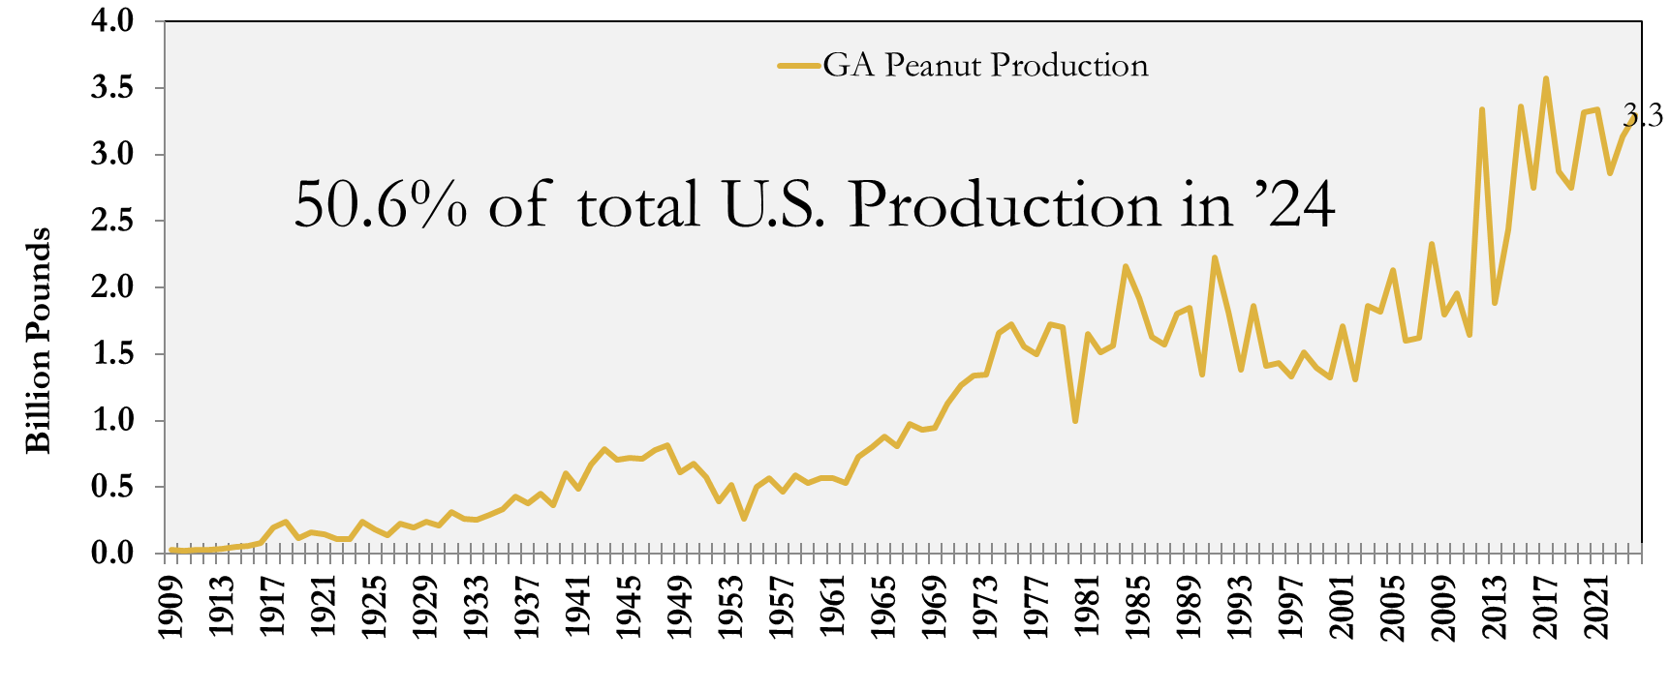
GA Peanut Production
Source: Data from USDA NASS
Yangxuan Liu
Notes:
GA peanut production level varies in response to market prices.
GA produced 50.6% of total U.S. Production in 2024, at 3.3 billion pounds.
National peanut prices recovered in January 2025 to 27.3 cents per pound for the week ending on January 11. If prices remain at the current, we would likely see more peanut acres in GA in 2024.

Slide 13
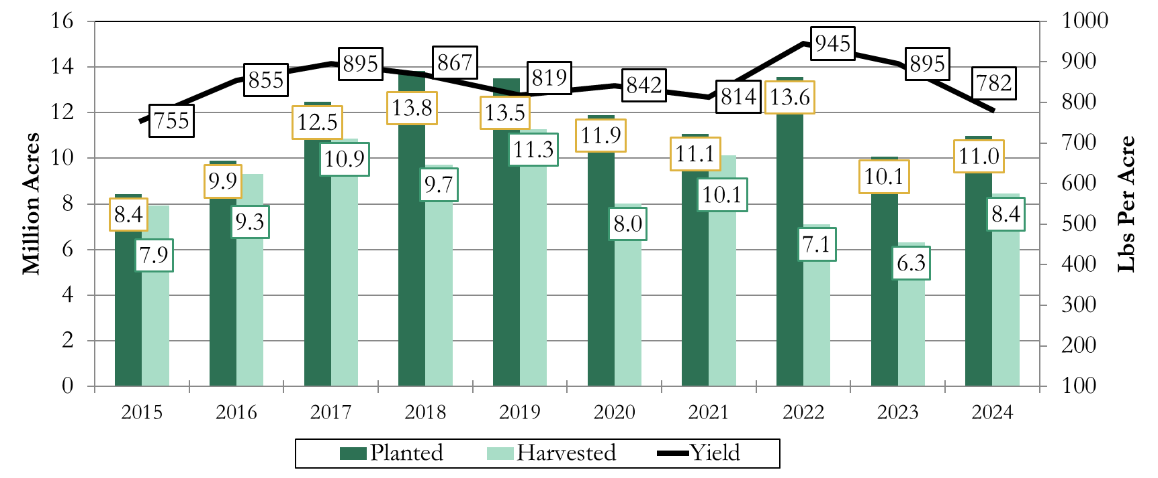
U.S. Upland Cotton Acres and Yield
Source: Data from USDA NASS
Yangxuan Liu
Notes:
Weather conditions and low prices resulted in low cotton production in the U.S.
U.S. Planted and harvested acres rose slightly in 2024 compared to 2023. 2024 planted acres is at 11.0 million acres, and harvest acres is at 8.4 million acres. But it is still at a relatively low level compared to 2018 or 2019.
Yield has been trended down, and in 2024, it is projected at 782 lbs per acre.
Based on the analysis, the cotton planted acres in the U.S. in 2025 will be approximately 11.44 million acres. This marks a slight increase from the previous year's 11.17 million acres.

Slide 14
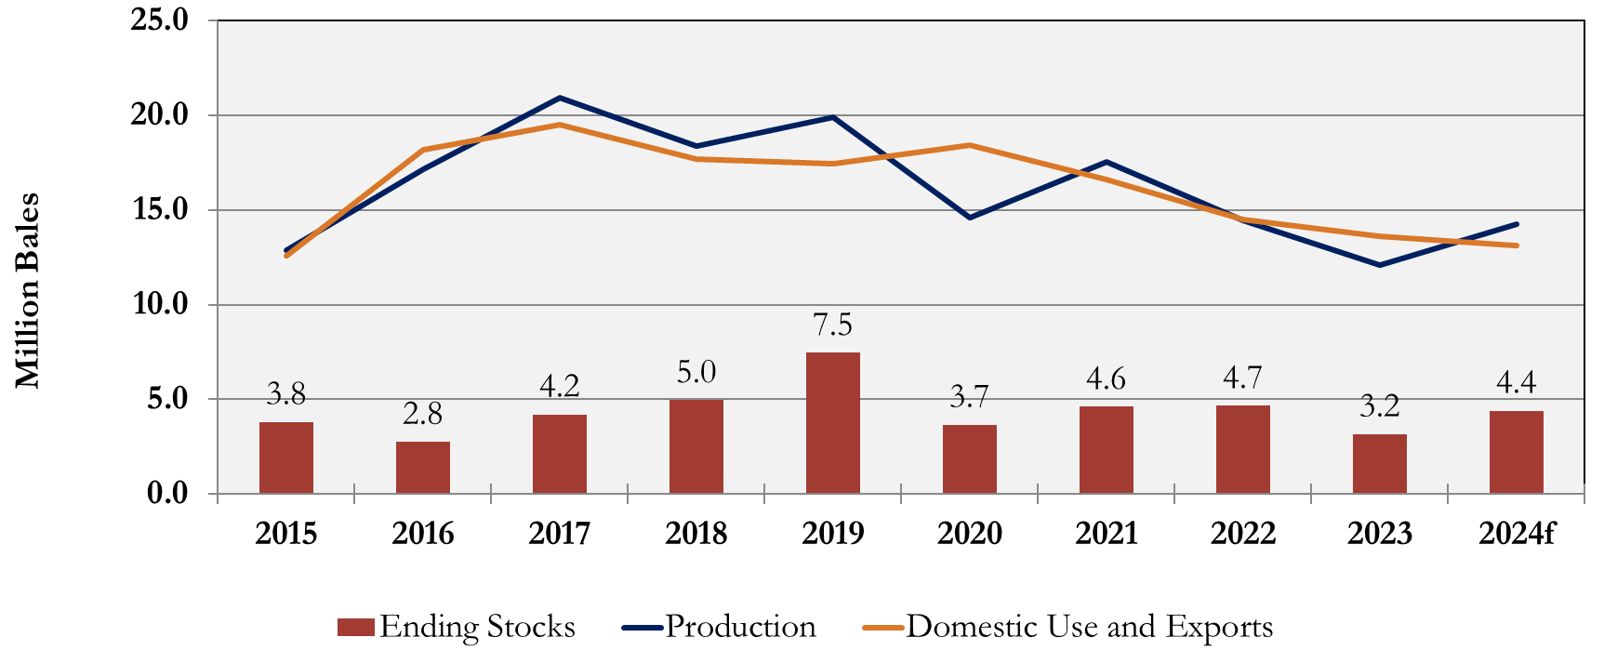
U.S. Cotton Supply and Demand
Source: Data from USDA FAS
Yangxuan Liu
Notes:
U.S. cotton supply exceed demand (domestic use and exports) in 2024, putting downward pressure on U.S. cotton prices. Because of increasing in competition in the global market, especially from Brazilian cotton, U.S. cotton demand haves been trending down since 2020.

Slide 15
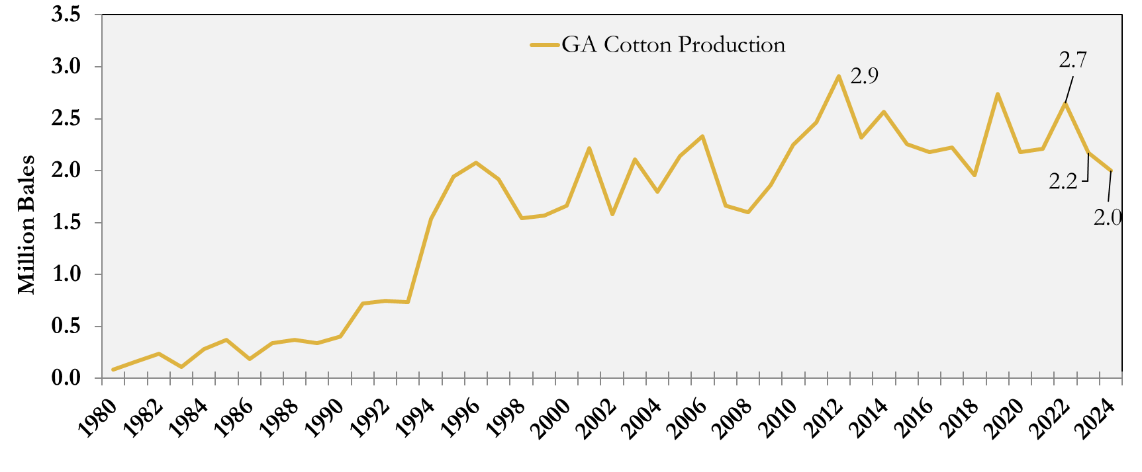
GA Cotton Production
Source: Data from USDA NASS
Yangxuan Liu
Notes:
Because of low cotton prices and the impact of Hurricane Helene, GA producers produced less cotton at 2 million bales in 2024, which is lower than the historical high in 2012 at 2.9 million bales, and second highest at 2.7 million bales in 2022. GA planted acres in 2025 will likely be maintained or reduced from the current level of 1.1 million acres in 2024, due to more favorable peanut and corn prices.

Slide 16
Planted Corn, Soybean, and Wheat Acres in Georgia
(2015 – 2024f)
Amanda Smith
Notes:
Here is a look at planted acres of corn, soybeans, and wheat for Georgia over the last ten years. In general, corn acres have trended up in the state since 2017, however in 2024, planted acres of corn were below 400,000 for the first time in 5 years to a total 375,000 acres. Georgia corn yields were projected to be 163 bu/ac for the 24/25 crop, down 11 bu/ac from the 23/24 crop and down for the third year in a row. If realized, this will result in Georgia’s smallest corn crop in 7 years at 49.7 million bushels.
Soybean acres bottomed out during the 19/20 and 20/21 crop years in Georgia and have gradually increased since. Growers planted 170,000 acres of beans for the 24/25 crop. Georgia state average soybean yields have also increased over the last three years and were projected at 47 bu/ac, up 4 bushels from the 23/24 crop. If realized, Georgia will have its highest soybean production in eight years at 7.6 million bushels.
Planted wheat acres have been on the decline over the last four years. Georgia growers planted 145,000 acres of wheat in 2024, the fewest acres planted to wheat in over 15 years and down 26% from the 23/24 crop year. On the other hand, wheat yields were projected up by 4 bushels to 59 bu/ac. If realized, Georgia wheat production will be 3.5 million bushels which is the smallest wheat crop in the past 5 years.

Slide 17
Index of Commodity Prices Received for Georgia Corn, Soybeans, & Wheat
(2019 = 100)
Amanda Smith
Notes:
Here is an index of market year average prices received by farmers in Georgia for corn, soybeans, and wheat with 2019/2020 market year average prices set to 100. The 19/20 market year, demarcated by the gray line, was the beginning of the pandemic and this index shows how much prices have changed since then. As you can see all three prices increased because of the U.S. and global recovery from the pandemic. However, prices began to decline following the 22/23 crop.
Georgia tends to see a strong positive basis for corn, a weak negative basis for soybeans and a strong negative basis for wheat.
Projections for Georgia season average farm prices for the 25/26 crop range from $4.70 to $5.10 per bushel for corn, $10 to $10.40 per bushel for soybeans, and $5.30 to $5.70 per bushel for wheat.
Planted acres for the state are likely to increase slightly for corn, decrease slightly for soybeans, and remain stable for wheat.

Slide 18
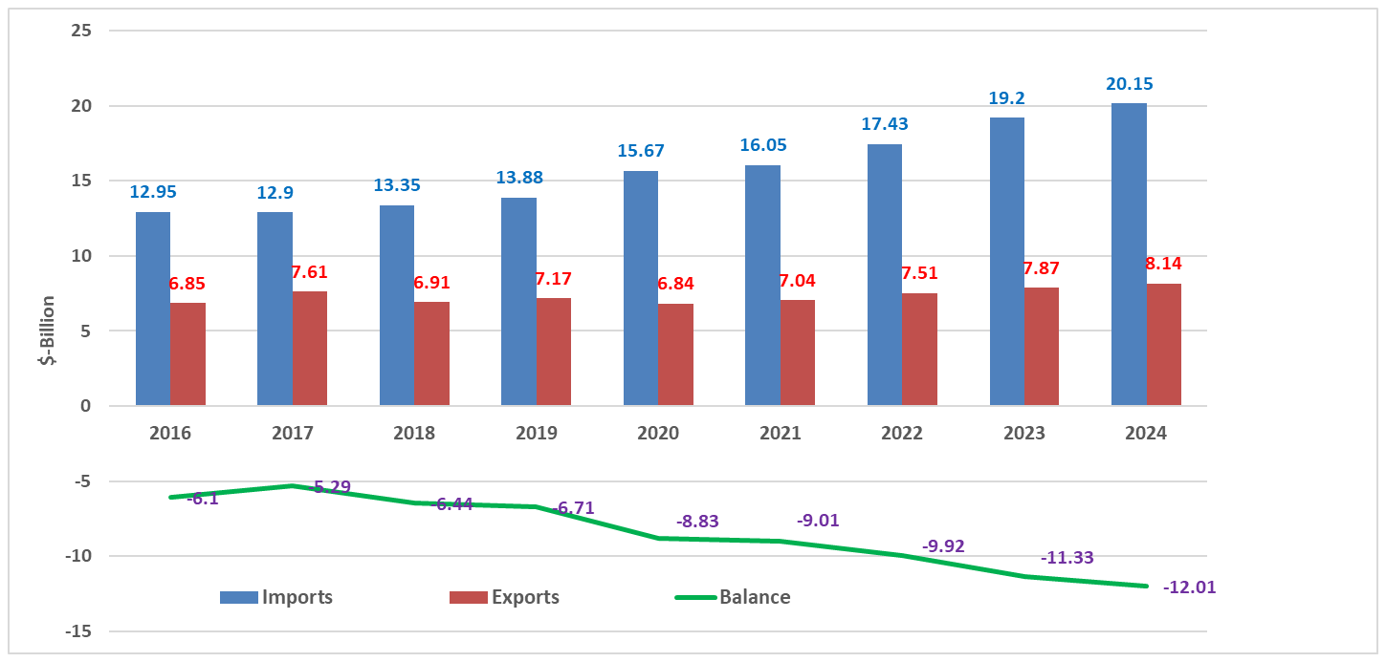
U.S. Vegetable Trade and Trade Balances, 2016-2024
For the past decade, the US imports more vegetables than it export.
Thus, vegetable negative trade balances have been drastically worsening.
In 2024, the negative trade balance was $12.01 billion, and this downward trend is expected to continue to 2025.
On the other hand, GA Vegetable Farm Gate values has been consistently growing.
Source: USDA, ERS, FAS
Greg Fonsah

Slide 19
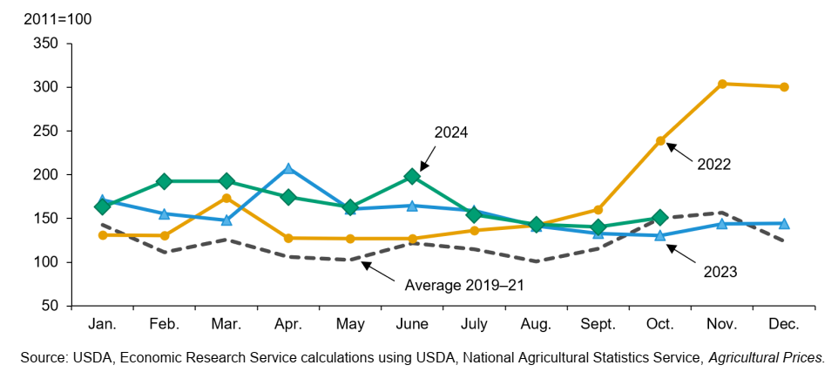
US Monthly Vegetable Price Index: 2019-2024
Vegetable price index has been strong since 2019-21 average and will remain strong in 2025.
The monthly vegetable prices will continue to be above the 2019-21 average but will be difficult to predict.
The 2024 Georgia’s 20-30% winter vegetable loss due to Hurricane Helene will not be enough to affect overall prices for 2025.
Greg Fonsah

Slide 20
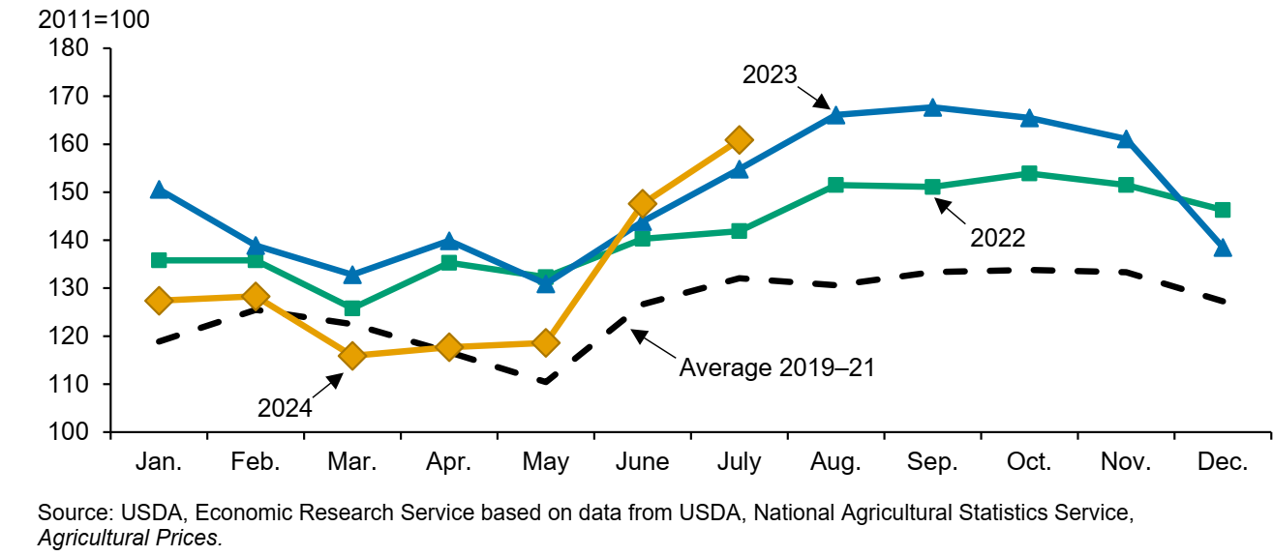
Fruit and Tree Nuts Growers Monthly Price Index: Jan – Dec., 2024
The 2024 growers price index started off lower than 2022 and 2023.
By July, the index was 160.9 (2011=100).
The July index was 4% higher than 2023 and 13% higher that 2022.
The lower fresh peach grower prices in June and July of 2024 compared to 2023 were partially blamed to increase in production in the Southeast and California regions.
Greg Fonsah

Slide 21
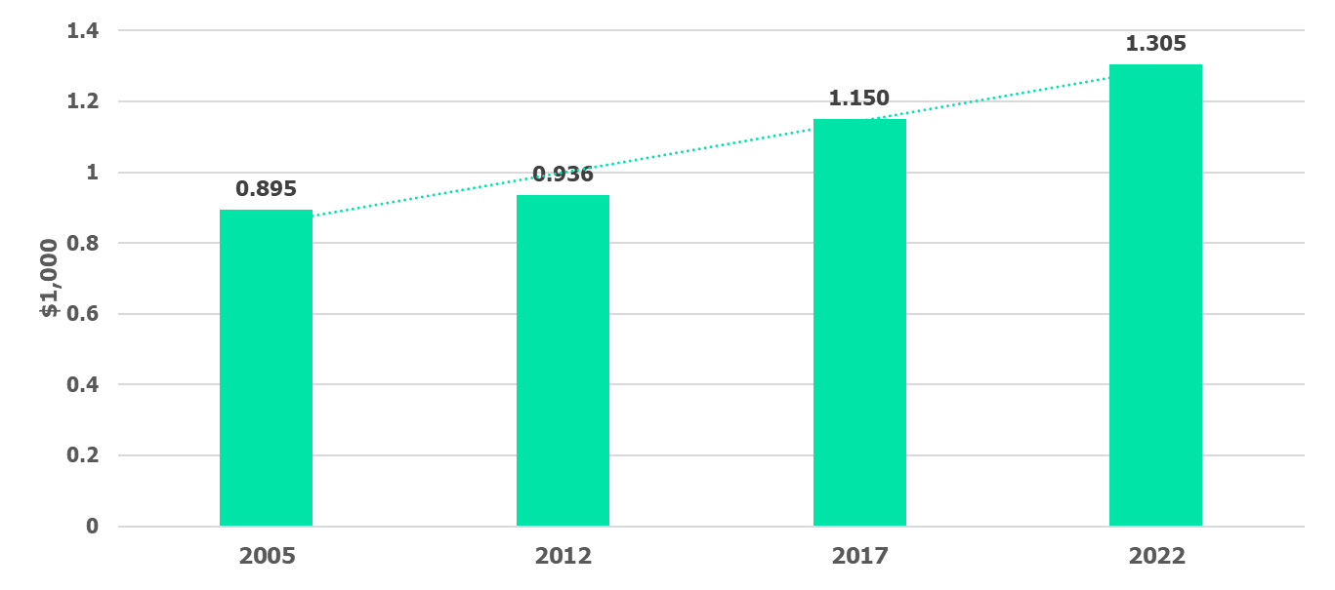
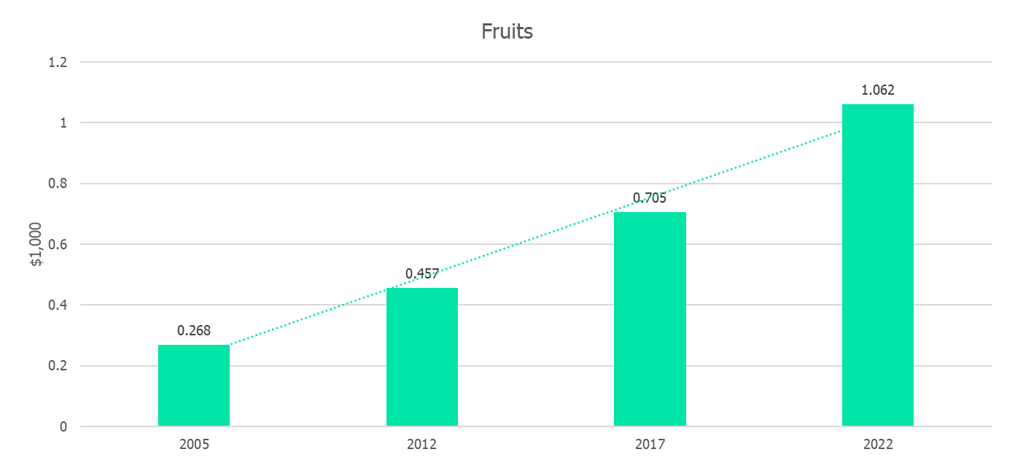
2024 GA Fruits & Nuts Industry Challenges
2005-24 GA Fruits Value = $1.1 Billion
In 2024, due to Hurricane Helene, GA Pecans industry suffered a loss of ~36 Million Pounds.
~75% pecan crop was damage with an estimated loss of $6.46 billion to the industry.
GA being the largest pecan producer, this loss might have an adverse effect on 2025 prices.
Also, GA blueberry industry suffered $52 million impact due to Hurricane Helene.
With additional $150 million impact on future quality losses.
The price for fresh peaches fell from $1.28 in June 2023 to $0.87 in June 2024, thus 32% decrease.
Despite all the challenges, the total GA farm gate values for the fruits and vegetable industry continue to increase for the past two decades and it is expected to continue in subsequent years.
Source: GA Farm Gate Value Report, Various Issues (2005-2024).
2005-2024 GA Veggies Value = $1.3 Billion
Greg Fonsah

Slide 22
Green Industry
Economy – cooling housing marker/renovations in many areas; CPI in-line with mid-2021 (off-2022 peak), uncertainty in economy
Weather – Above average temperatures, but increased precipitation
Hurricane Helene – uncertainty over supply and demand
Most likely there will be less Georgia production acreage in 2025, but stable to increasing demand for plants.
Though Georgia will likely fill any plant shortages with imports from other states, prices will most likely rise. Thereby, we would expect stable demand and higher prices in 2025.
Ben Campbell

Slide 23
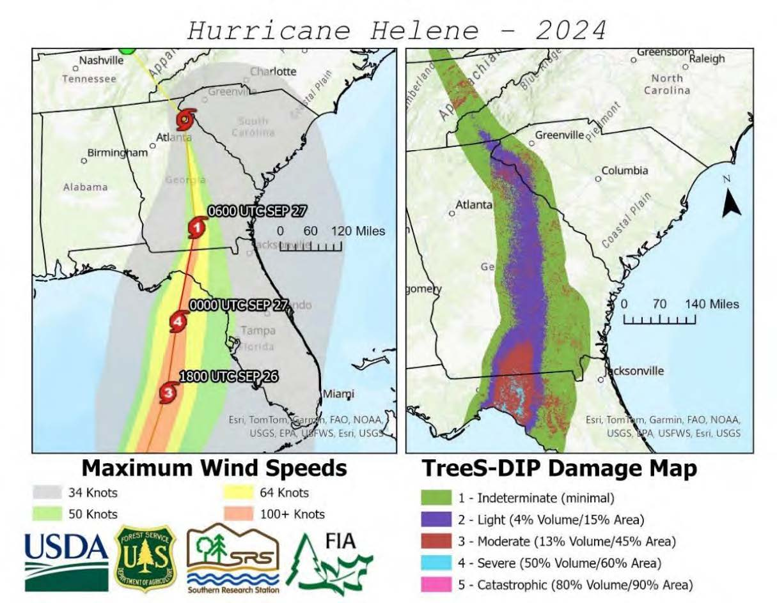
Timber
Demand for softwood lumber and panels is expected to remain under pressure
Hurricane Helene has a devastating impact on Georgia’s timber industry
Some affected areas may experience rising pine sawtimber prices in 2025 due to inventory shortage, while pulpwood prices are expected to stay low as timber salvage efforts continue
Timber prices in northern Georgia are expected to remain stable
Yanshu Li
Notes:
Over 70% of the U.S. softwood lumber and structural panels are used in residential construction, particularly single-family homes, and home improvement activities. Demand for softwood lumber and structural panels is expected to remain under pressure as single-family housing starts face challenges, including elevated mortgage rates, high house prices, and rising construction costs. From the supply side, Hurricane Helene impacted 8.9 million acres of Georgia’s forestland, including some of the state’s most productive timberland in South Georgia. The damaged pine timber is equivalent to the state’s annual timber harvest. While pulpwood prices in the affected region may stay low through mid-2025 as mills absorb salvaged timber, sawtimber prices are expected to rise for several years as these areas recover. Timber prices in northern Georgia remain stable.

Slide 24
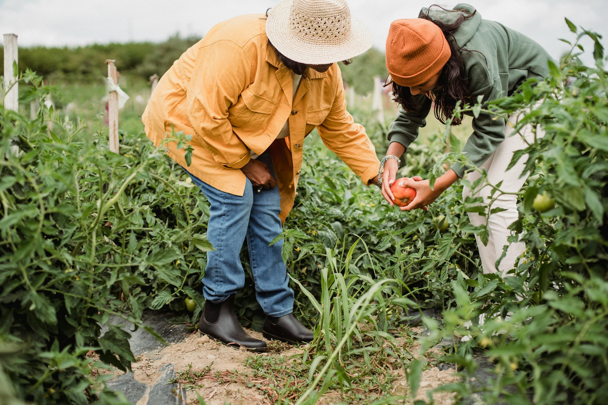
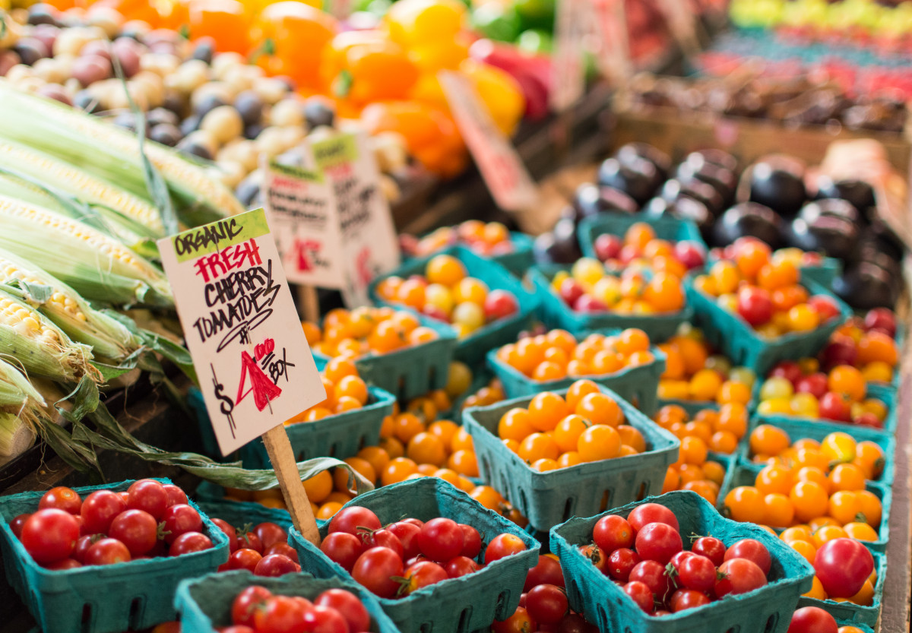
Direct-to-Consumer (DTC) Sales in Georgia
Take-Away:
Growing importance of DTC sales in Georgia's agricultural economy with share of farms involved in DTC sales over time remaining steady, and increase in DTC sales as a share of total farm sales.
  Dominance of large-scale operations in driving sales value.
  Small-to medium-sized of farms' contribution to sales revenue grew.
Per channels:
  Farmers market, in-person or online, gain traction, supported by non-profit organizations or Extension services.
  Community Supported Agriculture (CSA) have faced some challenges in Georgia, including declining sales and fewer returning customers.
  Online sales via platforms like Barn2Door are getting popular among farmers and shoppers, surfing on convenience.
State branding remains a staple in increasing awareness and visibility of Georgia Grown agricultural and food products.
Vanessa Shonkwiler
Angie Im
Notes:
Suggested narrative:
Direct-to-consumer (DTC) sales are a vital revenue source for farmers who welcome visitors and seek to build direct connections with customers.
The total value of agrifood products sold directly to consumers in Georgia experienced significant nominal growth over the past decade, increasing from $13.2 million in 2012 to $46.4 million in 2022.
The number of farms with DTC sales exceeding $1 million increased from 28 in 2017 to 32 in 2022 underscoring the pivotal role of large-scale operations in driving sales value, despite year-to-year fluctuations in their numbers.
It is also important to highlight that smaller-sized farms have steadily contributed to the growth of this segment, indicating that diversification and innovative approaches have allowed these operations to capture a growing share of the direct-to-consumer market.
The current state of direct-to-consumer sales in Georgia reflects a vibrant and evolving landscape, driven by the support of public and private entities, as well as innovative distribution models which have helped adapting to challenges.
Non-Profits supported initiatives. Whether managing physical distribution or food access to households with limited options, non-profits organizations have been instrumental in supporting DTC sales.
Cooperative Extension Services supported initiatives. Farmers’ markets remain a cornerstone of DTC sales in Georgia. They provide venues for farmers to engage directly with their communities, branding their stories and production practices.
Community Supported Agriculture (CSA) has become an increasingly common direct market channel for small-scale and mid-scale farmers. There are many different CSA models now, depending on the size, location, and products of the farm. Over the past few years, CSAs have faced some challenges in Georgia, including declining sales and fewer returning customers. Some reasons identified relate to consumers’ declining commitment as well as the increased competition from other DTC channels, especially online (e.g., Barn2Door).
State-Supported Branding Program will remain a staple. Since 2011, the Georgia Department of Agriculture's Georgia Grown program has played a pivotal role in promoting local agricultural products. This initiative provides marketing, branding, and networking support for all stakeholders involved in Georgia’s food supply-chain.

Slide 25
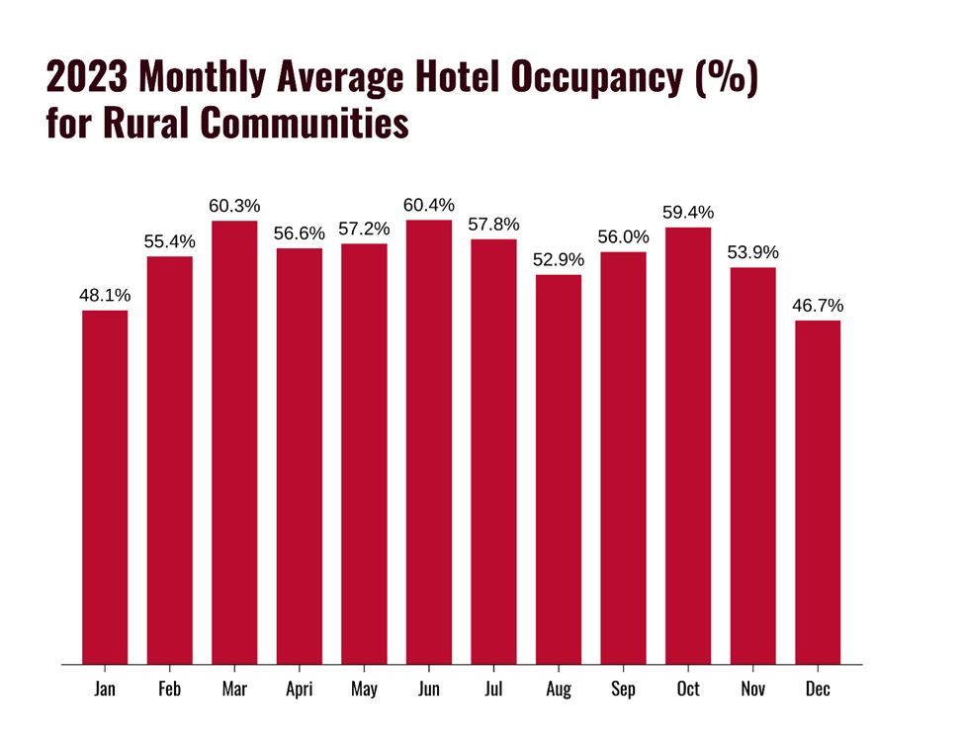
Hospitality
Georgia Rural Counties comprise a significant portion of all Georgia Counties.
Eighty-six (86) counties can be considered rural which are not aligned to metro areas, while 73 counties are aligned to one of five GA’s MSAs.
The highest visitor months in rural counties are June, March, and October.
This is important for information for local operators and producers because they can plan to enhance their services and/or direct to consumer sales efforts around these peak periods.
Dr. John Salazar

Slide 26
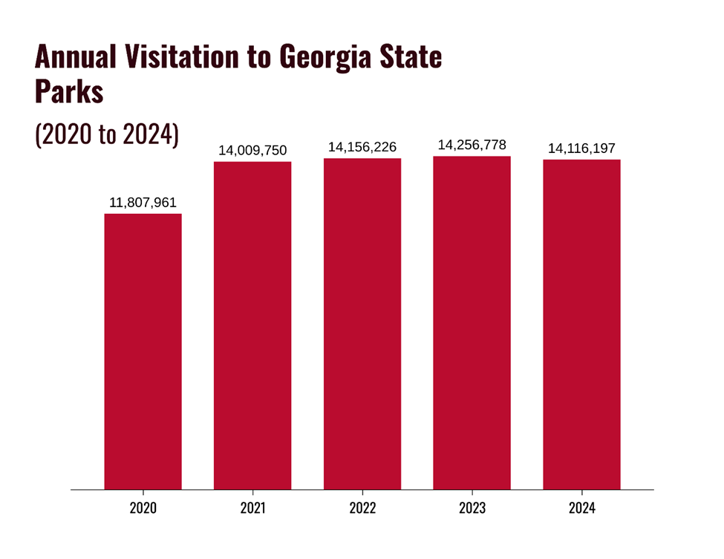
Hospitality
Georgia State Parks are important to visitors traveling the state.
Visitors to the state parks peaked in 2023 and are showing a leveling off for 2022 thru 2024. This leveling off will most likely continue through 2025.
Consequently, collaborating with the Georgia State Parks with your product and/or service marketing will be very important in 2025.
However, do not plan on an increased volume of visitors in your area affiliated with the State Park. Since increased visitor demand isn’t forecasted, enhance the quality of your service and/or attraction to increase direct to consumer sales opportunities.
Dr. John Salazar

Slide 27
Thank You

